Slide 1
Toxic Overflow: Detecting Hate Comments
Nur Bengisu Çam
Furkan Çağlayan
Ahmet Burak Kahraman

Slide 2

Overview of the Problem
What is toxicity on Social Media?
Why does it matter?
How to avoid?
What are the current approaches?
Perspective(Google)
Image by : Forbes

Slide 3
Dataset
Wikipedia Talk Pages comments from Kaggle challenge
Challenging in couple of ways
Multi-class or Multi-label
Tags: toxic, severe toxic, insult, threat, obscene and identity hate
One more label : clean

Slide 4
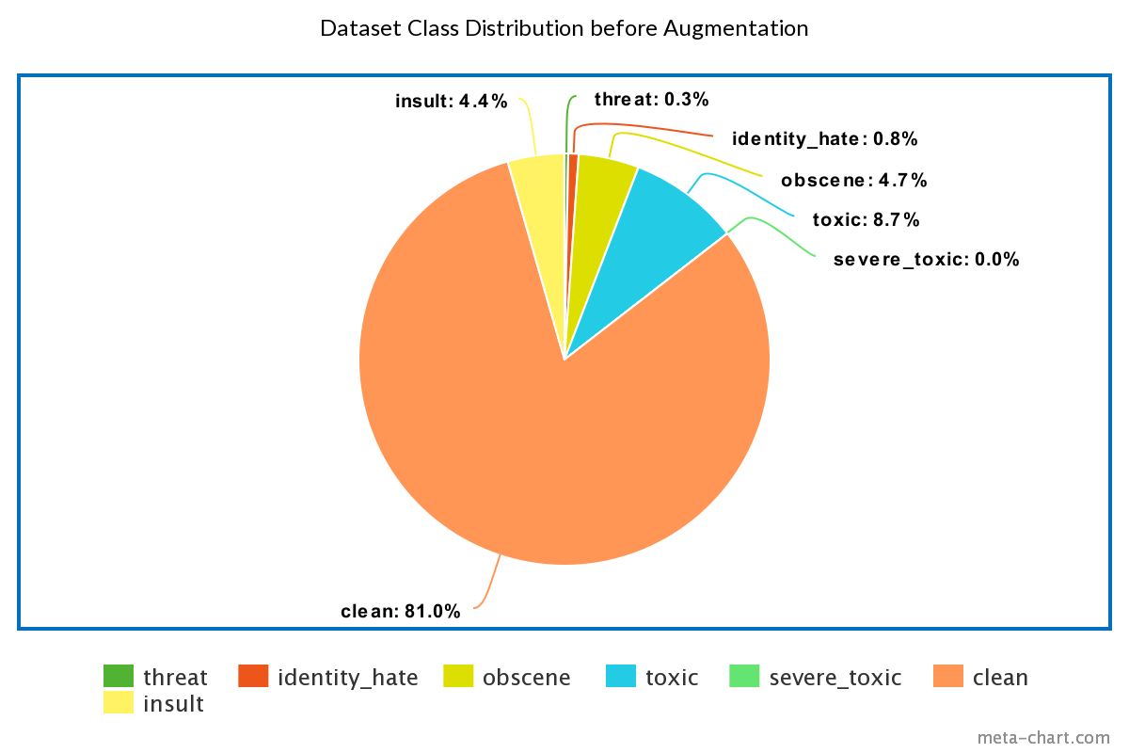
Dataset

Slide 5
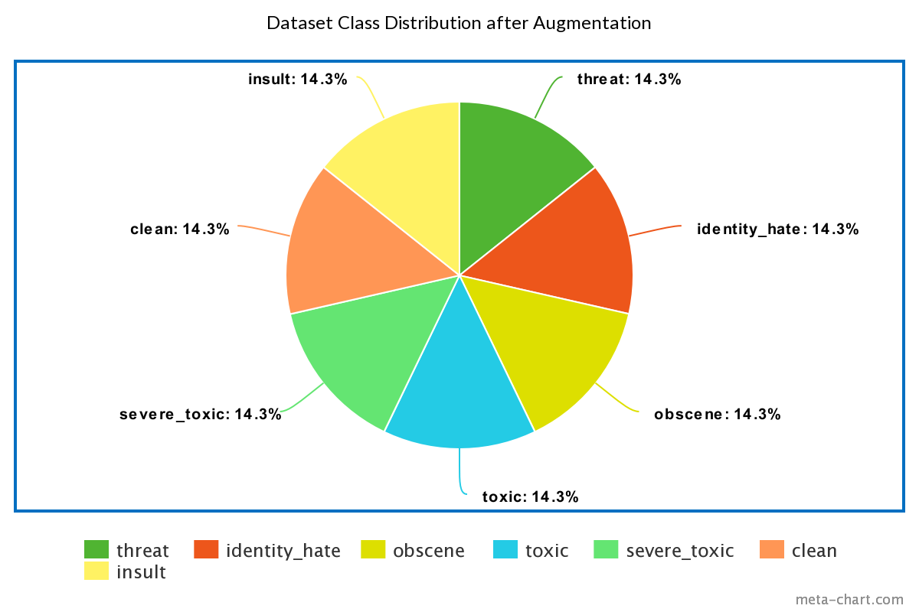
Dataset
This approach did not work well for ‘clean’ data!

Slide 6
Common Approaches
Machine Learning based methods
Decision Trees
Naive Bayes
SVM
Ensemble based methods
Deep learning based methods
CNN
RNN(LSTMs)

Slide 7
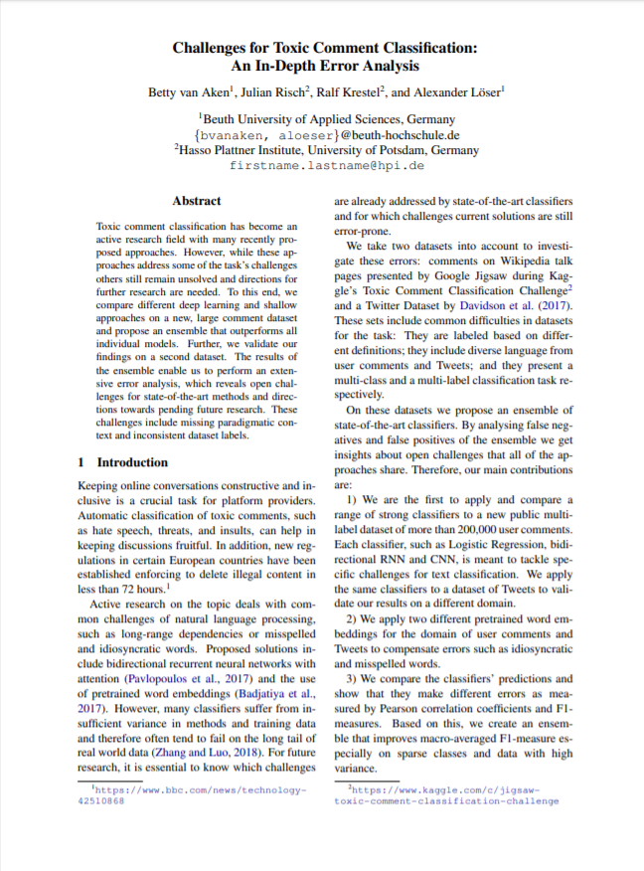
Overview of the Paper
2 different datasets(wikipedia & twitter)
Out-of-Vocabulary Words, Long-Range Dependencies & Multi-Word Phrases
Toxicity without swear words
- 30% of the Wikipedia dataset
- 43% of the Twitter dataset
- Non-toxic comments with swear words included just to make irony or metaphors

Slide 8
Overview of the Paper - CONT.
Logistic Reg., CNN, RNN
CNN + Logistic Reg. + Word Embeddings for Ensemble Learning
Glove, FastText
Detailed Error Analysis on both datasets
Suggested to use Ensemble Learning

Slide 9
Our Approach
Pre-processed corpus
Word-embeddings for augmentation
Applied well-known algorithms
Mostly focused on Ensemble Learning
Used TfidfVectorizer with stop-words removal to represent each word

Slide 10
Data Pre-processing
Clear punctuation
Example | Original | Processed
Comment | Praise looked at this article about 6 months ago -much improved. ] | praise looked at this article about 6 months ago much improved

Slide 11
Data Pre-processing
Example | Original | Processed
Comment | Online ambassador Hey there! I'd be happy to help out; have you read the Public Policy tutorials yet? | online ambassador hey there i would be happy to help out have you read the public policy tutorials yet

Slide 12
Word2Vec Embeddings
A word is characterized by the company it keeps(Firth)
Trained our own model
Similar word examples
book → books, paper, publisher
material → content, information, text
online → internet, web, available
stupid → dumb, pretentious, pathetic

Slide 13
Word2Vec Embeddings Examples
ORIGINAL | OUR MODEL | NLTK MODEL
book | books | books
material | content | materials
stupid | dumb | dumb
online | internet | Not in the dictionary

Slide 14
Data Augmentation
word2vec
Example | Text
Original | i ca not believe no one has already put up this page dilbert desktop games so i did
Augmented | i ca not believe any only since yet put up here entry dilbert internet explorer snooker so myself ca not

Slide 15
Data Augmentation
Example | Text
Original | a pair of jew hating weiner nazi schmucks
Augmented | a pair of jew brainwashed weiner nazi schmucks

Slide 16
Data Augmentation
Example | Text
Original | unsure at this stage its not very clear what wording is actually being discussed
Augmented | unsure at this stage our but pretty obvious what wording represents what were explained

Slide 17
AdaBoost
Naive Bayes
Decision Trees
Also, average of the NB, DCs and SVM

Slide 18
Experimental Results
 | Toxic | severe_toxic | obscene | insult | i_hate | clean
N. Bayes | %47.4 | %67.0 | %65.8 | %65.8 | %71.6 | %60.0
D. Tree | %62.5 | %76.3 | %60 | %63 | %79.5 | %49.0
SVC | %58.3 | %74.6 | %60.0 | %59.8 | %78.8 | %56.3
AdaBoost D.Tree | %70.1 | %85.6 | %83.6 | %81.8 | %81.6 | %77.5
AdaBoost Bayes | %58.1 | %74.8 | %58.6 | %58.3 | %79.1 | %75.7

Slide 19
Discussions & Improvements
Strengths & Weaknesses
Does augmentation work?
Possible problems?
What can be improved?

Slide 20
Future Work
Use embeddings to correct the miswritten words
Vectorize abridgments
Use stronger embedding methods
Hierarchical models ( Bert, Albert )
WordNet

Slide 21
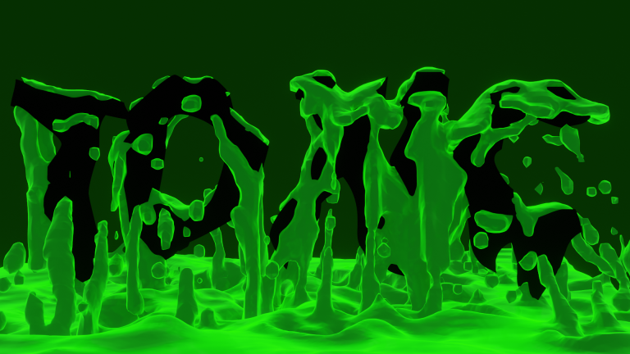
Thanks for Listening!

Slide 22
References
Kaggle Toxic Comment Challenge
Perspective

